Slide 1
BT 205: Cell & Molecular Biology
-Prof. Siddhartha Sankar Ghosh

Slide 2
Splicing of mRNA
5’ Capping
3’ Polyadenylation

Slide 3
Formation of the primary transcript and its processing during maturation of mRNA in a eukaryotic cell

Slide 4
Q. How do you calculate the number of exons and introns in a linear and a circular DNA?

Slide 5
Steps Involved
Formation of the primary transcript and its processing during maturation of mRNA in a eukaryotic cell.
The 5′ cap (red) is added before synthesis of the primary transcript is complete.
A noncoding end sequence (intron) following the last exon is shown in orange.
Splicing can occur either before or after the cleavage and polyadenylation steps.

Slide 6
The 5′ cap has four main functions:
Regulation of nuclear export
Prevention of degradation by exonucleases
Promotion of translation
Promotion of 5′ proximal intron excision

Slide 7
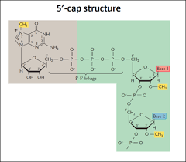
In eukaryotes, the 5′ cap (cap-0), found on the 5′ end of an mRNA molecule, consists of a guanine nucleotide connected to mRNA via an unusual 5′ to 5′ triphosphate linkage. This guanosine is methylated on the 7 position directly after capping in vivo by methyltransferase. It is referred to as a 7-methylguanylate cap, abbreviated m⁷G.

Slide 9
The 5′ cap of mRNA
(a) 7-Methylguanosine (m7G) is joined to the 5′ end of almost all eukaryotic mRNAs in an unusual 5′,5′- triphosphate linkage.
Methyl groups (light red) are often found at the 2′ position of the first and second nucleotides. RNAs in yeast cells lack the 2′-methyl groups.
The 2′- methyl group on the second nucleotide is generally found only in RNAs from vertebrate cells.
(b) Synthesis of the cap is carried out by enzymes tethered to the CTD of Pol II. The cap remains tethered to the CTD through an association with the cap-binding complex (CBC).

Slide 10
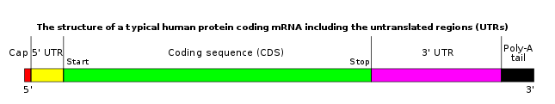
Polyadenylation:
It is the addition of a poly(A) tail to an RNA transcript, typically a messenger RNA (mRNA). The poly(A) tail consists of multiple adenosine monophosphates; in other words, it is a stretch of RNA that has only adenine bases. In eukaryotes, polyadenylation is part of the process that produces mature mRNA for translation.

Slide 11

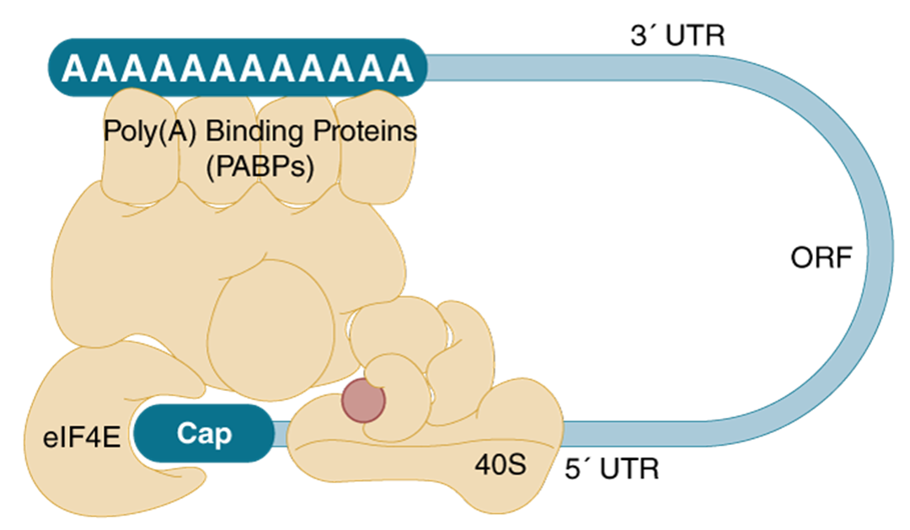

Slide 12
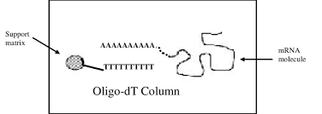
Oligo-dT Cellulose Columns. Oligo dT isolation is a very useful method for isolating sequences with a poly A tag.

Slide 13
Splicing mechanism of group I intron
The nucleophile in the first step may be guanosine, GMP, GDP, or GTP. The spliced intron is eventually degraded.

Slide 14
Splicing mechanism of group II intron

Slide 15
Splicing

Slide 16
THANK YOU

